Slide 1
The Agile Developers survival Guide

Slide 2
Chicken soup for the Monolith Developers soul
Notes:
Exercise: Being that this is a workshop and today we’re going to be building the backend of a fitness application, I think we should start this off with an exercise.
An exercise that I know everyone can do is, meet someone new. After all, that’s what today is all about. Learning, growing, community. So please, take a few minutes to learn something about someone you don’t know.
A the end, there will be a pop quiz and whoever remembers the most get’s an invite to my wedding.
If you were hoping I meant a physical exercise, that’s on Friday in this room, myself and Tony Thigpen will be presenting Refactoring your Health.

Slide 3
Microservices in a day
Using ASP.NET Core 2.2.3 and AWS

Slide 4

David Merk
Software Engineer at QSR Automations
Blog: https://davewritescode.com
LinkedIn: https://linkedin/in/davewritescode
GitHub: https://github.com/dvdmrk
Hobbies:
Fitness
Development
Startups

Slide 5



Scott sCHUENEMEYER
Software Engineer at QSR Automations
Hobbies:
Reading
Video Games
Board Games

Slide 6
prerequisites
Download the instructions
https://aws.amazon.com/free/
Download .NET Core 2.2.3 SDK
https://github.com/dvdmrk/fitnesstracker
Sign up for AWS Free Tier
https://dotnet.microsoft.com/download/dotnet-core/2.2

Slide 7
Why Microservices
According to Richardson’s Microservice Patterns, they enable a rapid, rabid, and reliable pattern for delivering large complex applications.

Slide 8
Why this workshop
I’ve made mistakes so you don’t have to. This is the culmination of my bad architecture redemption arc.

Slide 9

FullStack Developers
Backend Developers
Implementing HATEOS
Kafka/ Dyanmo Service Per API
Notes:
I want to find out who I’m talking to in here.
Are there any front end developers?
Fullstack developers?
Who’s building restful APIs?
Who’s implementing HATEOS APIs?
Who’s already working with microservices?

Slide 10
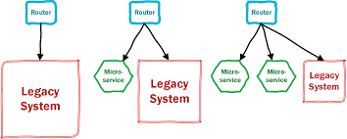
The strangler pattern
This is what we’re doing today:
Separating the Logic and Presentation Layers of an MVC Application
Creating a new feature as a service
Replacing existing funcationality

Slide 11
Chapter 1) N-tier Architecture
Any system consisting of at least 3 layers. Typically separated into: Data Management, Presentation, and Logic.

Slide 12

Entity Framework
Notes:
This is an ORM, we’re going to implement it. Actually .NET is going to implement it for us, and we’re going to build with it.

Slide 13
ASP.NET Identity
Notes:
This is an Identity Store for .NET it builds out user profiles and sign ups, in chapter 3 we’re going to build it out and expose it as an API.

Slide 14
Automapper
If Jimmy Bogard is here, ask him to leave.

Slide 15
.NET Core DI
Notes:
We’re going to get a lot of practice with this today. Dependency Injection decouples the creation of an object from its instantiation.

Slide 16
ViewComponent
Notes:
View Components replace Partial Views in .NET Core

Slide 17
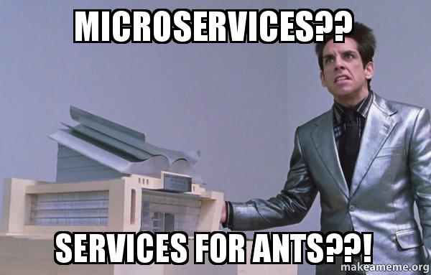
What are Microservices?

Slide 18
Chapter 2) MICROSERVICE Architecture
Microservices are independently developable, deployable, and scalable services centered around business capabilities that work together to resolve business objectives.
Notes:
Without going too deep into the theoretical…

Slide 19
Configure Swagger Duplicate crud build a new project

Slide 20


Why use swagger
API:
Design
Development
Testing
Documentation

Slide 21

Chapter 3
JWT and Authentication

Slide 22
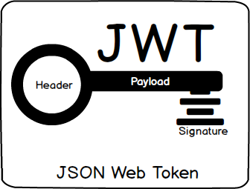
Jwt aUTHENTICATION
Notes:
In this application we are going to sign and send our own JSON Web Tokens. As outlined in the picture above, each token has a header, a payload, and a signature. We are also going to be implementing our own signature, “CodePaLOUsa2019!” one rule of these signatures is that they need to be at least 16 characters. We will be passing the tokens back with a payload of the ClaimType NameIdentifier, and the ClaimType Role.

Slide 23


Postman is a wonderful tool for testing apiS
Notes:
How do I authenticate between services was one of the first questions I was tasked to answer when I started working with microservices. The implementation I went with back then was the Service to Service flow using Oauth and Azure API Management Gateway.

Slide 24
The api maturity model hypermedia and returning errors
Chapter 4

Slide 25
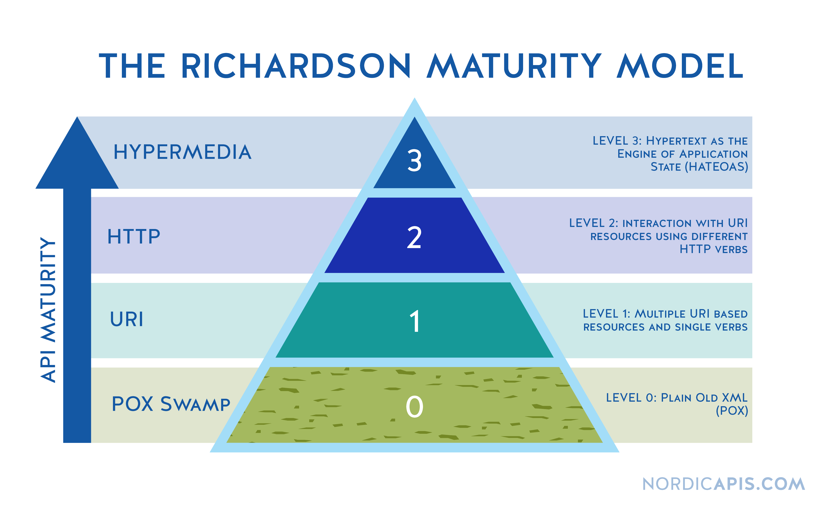
One of the things I really wish I knew when I started working with microservices
Notes:
HATEOS is a great goal, but so is GraphQL and it would rank 0 on here. The goal of this workshop is that if you’re new to writing APIs, you try to make them as consumable as the timeframe allows you.

Slide 26
Communication cache and multiservice authentication
Chapter 5
Notes:
This is the part of the workshop where things really get bonkers. I want to wait until everyone is caught up before I talk about this.
The Microservices we build today will communicate via HTTP. They will authenticate via HTTP. They will error via HTTP.
This is probably some of the easiest code to follow so I want to make sure I take some time to talk about the problem this pattern solves.

Slide 27

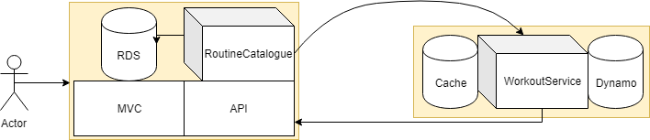

Slide 28
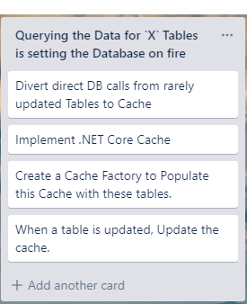
Patterns solve problems
This is the problem this pattern solves.
Notes:
We implement a Cache DB and keep it updated by rehydrating it with the DB when values change.

Slide 29
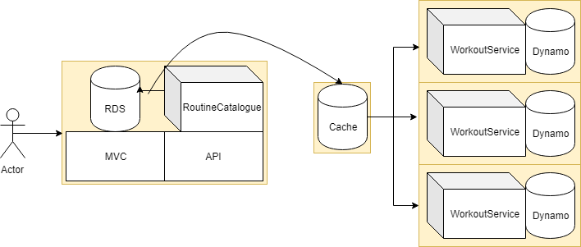
Using a redis cache between services
This is what it would look more like at scale.

Slide 30

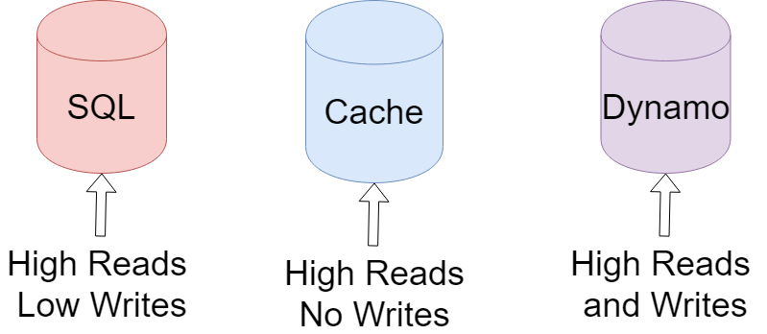
Chapter 7
DynamoDB
Notes:
Dynamo is a super quick single digit millisecond response time document DB. It’s AWSs NoSQL DB.
We use a relational database for our relational data, however in our new service we’ll be uploading the results of each set as a workout and the culmination of each routine as a workout routine, and storing a users entire workout history can offer a considerable advantage for this nonrelational piece of data as it can be loaded into memory more quickly than it can be querried from a sql database.

Slide 31
Chapter 8
Pub/Sub
Notes:
Is currently an API implementation of the Pub Sub pattern making the microservices “event driven”; however there’s a better implementation still in development for the next presentation of this workshop using SQS to queue and receive messages, SNS to fan those messages to multiple subscribers. There are other non cloud implementations such as Rabbit MQ.
There are two pattern in this chapter that will help you implement and evolve your technologies.

Slide 32
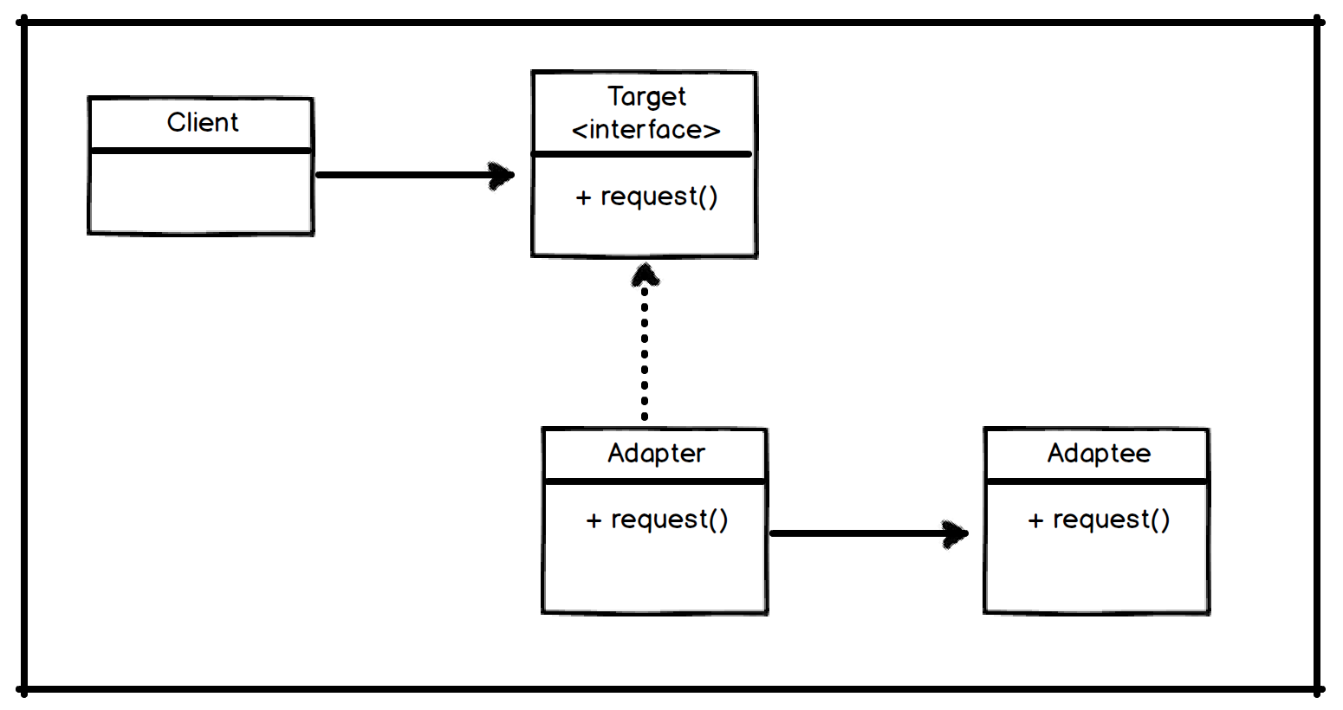
Adapter pattern
In our example we are using the interface IPublisherAdapter
The PublisherReposiotry has a, “Has A” relationship with this adapter interface
This Publisher interface is implemented through the Publisher class, however when a more robust implementation is available such as Rabbit MQ, or SQS- you will be able to substitute the implementation in the DI
Publishing takes place through the IHTTPClient Abstraction RestEase

Slide 33
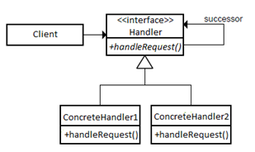
Chain of Responsibility
This pattern uses both the “Is A” and “Has A” relationships.
We implement Publisher Repo which is an IRepo and it has the generic Repo.
This allows us to preform an implementation, followed by another composable implementation.

Slide 34

The end
https://linkedin/in/DaveWritesCode
https://github.com/dvdmrk
https://DaveWritesCode.com

Slide 35

special Thanks
https://www.qsrautomations.com/company/careers/

Slide 36
